Slide 1
Technology And Mental Health
Name : Swati Vala
ID No. : 25IT445
Sub. : Web Technology

Slide 2
Introduction
What is Technology ?
Technology means the tools and machines we use in daily life.
such as mobile phones, computers, the internet, and apps.
It helps us communicate, learn, and work faster and easier.
What is Mental Health ?
Mental health means how we think, feel, and handle stress in our daily life.
It affects our emotions, behavior, and how we deal with people and problems.

Slide 3
Positive Effects of Technology on Mental Health
Mental health apps
Online counseling
Social media & messaging
Educational videos
Apps like meditation or breathing apps help people feel calm and relaxed.

Slide 4
Negative Effects of Technology on Mental Health
Too much screen time
Social media comparison
Online bullying
Addiction to phones or games
Spending too much time on social media can make people feel anxious or unhappy.

Slide 5
Technology and Students’ Mental Health
Technostress
Lack of concentration
Self-Respect
Easy and interesting

Slide 6
How to Use Technology in a Healthy Way
Limit screen time
Take regular breaks
Avoid phone before sleeping
Follow positive and educational content
Talk to family and friends offline too

Slide 7
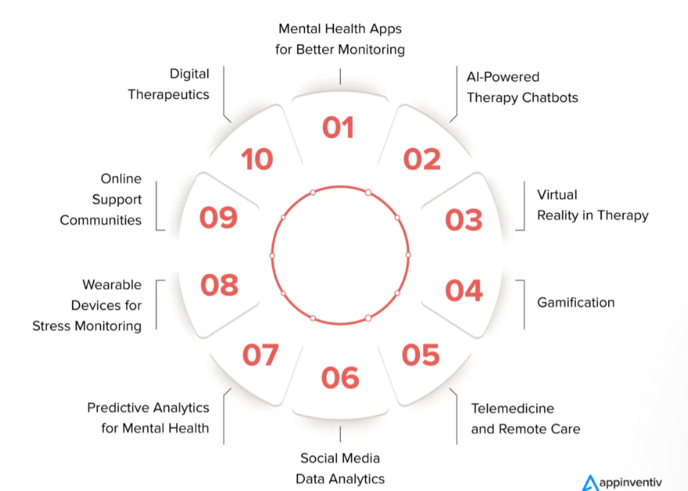
Future of Technology in Mental Health

Slide 8
CONCLUSION
Technology can make mental health better or worse. As we look at how they mix , we need to think about the good and bad sides , and also the right and wrong parts. This way , we can use technology to make everyone’s mental health better in the future.
“In the future, technology will not replace humans, but it will strongly support mental health care.”

Slide 9


